Slide 1
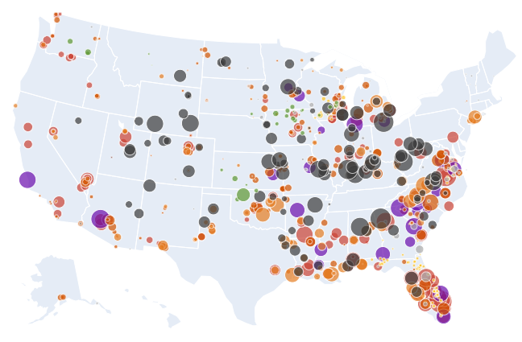
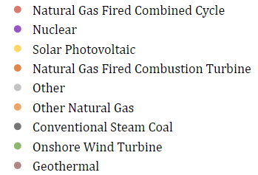
Technology
Capacity
500 MW
1000 MW
2000 MW
3000 MW

Slide 2
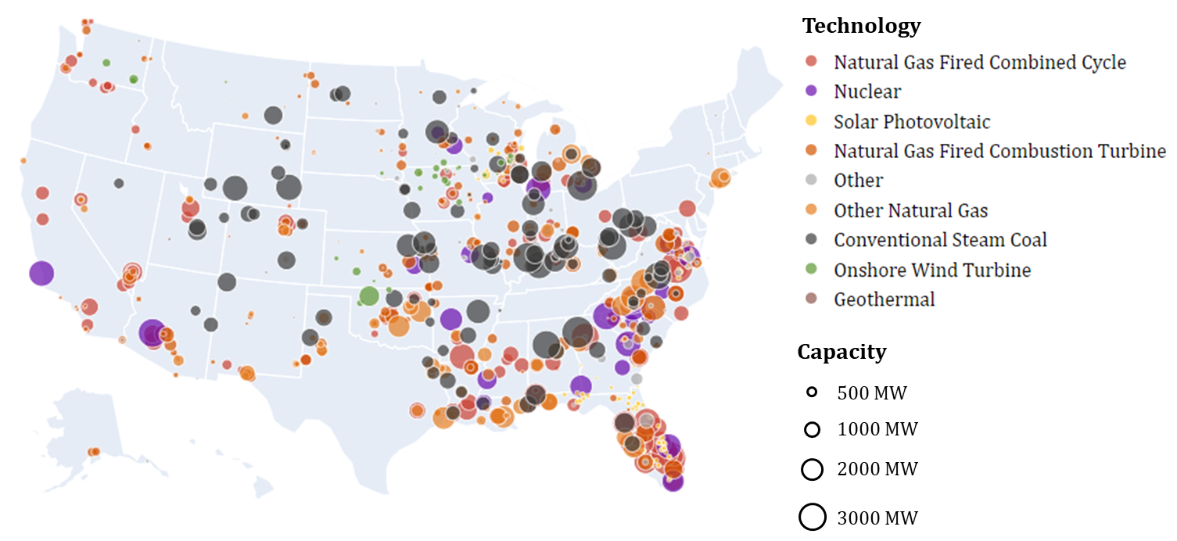

Slide 3
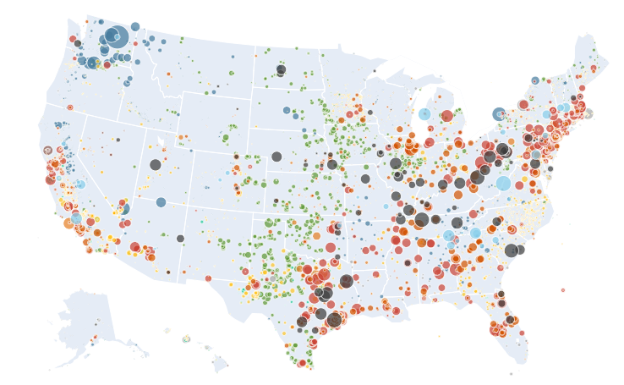
Technology
Capacity
500 MW
1000 MW
2000 MW
3000 MW

Slide 4
